Slide 1

Minor Project –IA1 Bachelor of Science (Honors ) V Semester – 2023
School of Computer Science and Applications

Slide 2
A PROJECT REPORT ON Automating Server Configuration Using Ansible
Submitted IA-1 Project report completion of B.Sc. (H) degree
Presented by:
Mr. Mohammed Afzal
SRN: R21DB024
Mr. Mohammed Aftab
SRN: R21DB023
Internal Guide : Dr. Senthil
External Guide :

Slide 3
Agenda
Introduction
Abstract
Literature Survey
Software Hardware Requirement
Existing System and Proposed System
Module Description
Form Design
Result

Slide 4
Introduction:
In today's fast-paced and interconnected world, organizations increasingly rely on web applications to streamline their operations and provide efficient services to employees and customers. As part of our college minor project, we embarked on a journey to design, implement, and manage a robust Employee Web App infrastructure in Amazon Web Services (AWS) using Ansible automation.
Our project aims to showcase the practical application of cloud computing and infrastructure as code (IAC) concepts. By leveraging AWS's extensive suite of services and Ansible's powerful automation capabilities, we have created an architecture that embodies scalability, high availability, security, and efficiency.

Slide 5
Abstract
Our project focuses on constructing an Employee Web App infrastructure within Amazon Web Services (AWS) utilizing the power of Ansible automation.
The project's primary objectives involve showcasing Ansible's efficiency in simplifying complex AWS infrastructure management, promoting IAC principles, and imparting skills to harness Ansible for cloud deployments. The documentation serves as an instructive guide, elucidating Ansible-driven infrastructure as code. Readers gain insights into how Ansible optimizes AWS resource management, champions IAC best practices, and facilitates efficient, scalable cloud infrastructure deployment.
Our infrastructure encompasses two AWS Virtual Private Clouds (VPCs) and vital components including Elastic Compute Cloud (EC2) instances, DynamoDB, Elastic Load Balancer (ELB), Amazon CloudWatch, Amazon S3, and a Lambda function. The key innovation lies in Ansible, which streamlines resource provisioning and configuration through automated workflows.

Slide 6
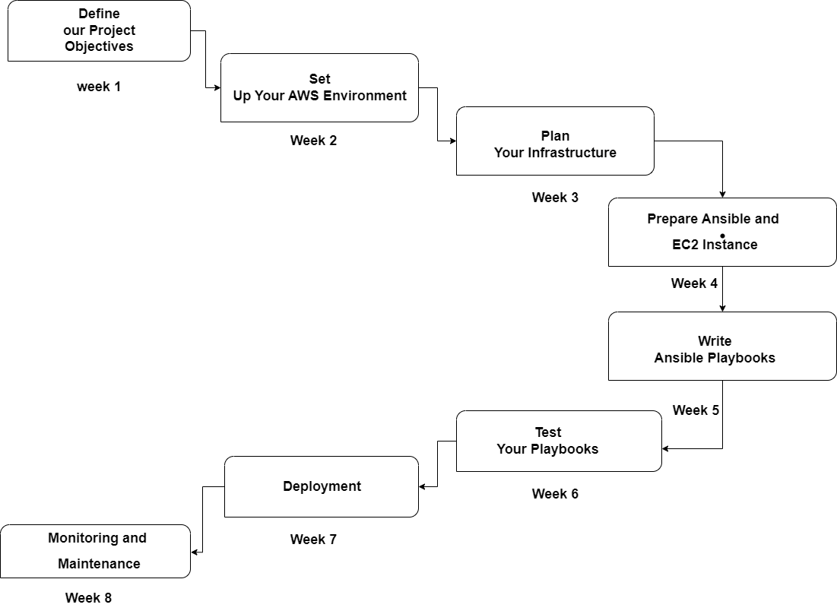
Project Roadmap

Slide 7
Literature survey
AWS Cloud Infrastructure:
https://aws.amazon.com/architecture/well-architected/
Ansible Automation:
https://docs.ansible.com/ansible/latest/collections/amazon/aws/index.
Serverless & Lambda Functions:
https://docs.aws.amazon.com/lambda/
Flask web application framework
https://devdocs.io/flask~2.1/
Boto3:
https://boto3.amazonaws.com/v1/documentation/api/latest/index.html/

Slide 8
Software Hardware Requirement
Software Requirements:
Operating System: Linux-based OS for the Ansible control node.
Ansible: Installed on the control node.
AWS CLI: Installed for AWS interaction.
Text Editor: A code editor for Ansible playbooks.
Monitoring and Logging: Set up AWS CloudWatch and logging solutions.
Hardware Requirements:
Control Node: EC2 instance with adequate CPU, RAM, and storage.
Target Infrastructure: EC2 instance types tailored to your workload.
Networking: Configured VPC, subnets, and security groups.
Internet Connectivity: Required for control node's AWS communication.
Backup and Redundancy: Implement data and infrastructure redundancy.

Slide 9
Existing System and Proposed System
Existing System:
Infrastructure: Describe the current infrastructure setup and manual processes in use.
Scalability: Highlight limitations in scalability and high availability.
Automation: Mention if any automation or infrastructure as code is currently in place.
Proposed System:
Infrastructure: Explain the planned AWS infrastructure and Ansible automation.
Scalability: Emphasize improved scalability and high availability.
Security: Discuss enhanced security measures and compliance.
Benefits: Highlight advantages like reduced manual effort, cost-efficiency, and faster deployments.
Challenges: Acknowledge potential challenges and risk mitigation.
Outcomes: Specify expected outcomes, such as improved infrastructure management and reliability.

Slide 10
Module Description
Objective: Configure AWS infrastructure for web application hosting.
Components: VPC, EC2, RDS, IAM, S3, CloudWatch, DynamoDB, Lambda, ansible
Description: The "AWS Infrastructure Setup and Configuration" module is responsible for the provisioning and configuration of the project's AWS infrastructure. It employs Ansible, an open-source automation tool, to automate the setup, ensuring consistency, reproducibility, and scalability of the AWS resources required for the Employee Web Application.
VPC Creation:
Ansible plays a vital role in creating Virtual Private Clouds (VPCs) to isolate the project's resources. It configures VPC components such as subnets, route tables, and internet gateways.
EC2 Instance Deployment:
Ansible automates the launch of EC2 instances, specifically the control node that hosts Ansible itself. This EC2 instance becomes the central orchestrator for the infrastructure setup.

Slide 11
Module Description
Security Group and Network Configuration:
Security groups and network settings are defined using Ansible playbooks. It ensures that EC2 instances are securely isolated, and network traffic is appropriately controlled.
Integration with AWS Services:
The module establishes connections with various AWS services, such as DynamoDB for data storage, S3 for image storage, Lambda for image processing, and Elastic Load Balancer (ELB) for high availability. Ansible roles are created to configure these services.
Parameterization and Reusability:
Ansible allows for parameterization of infrastructure settings, making it easy to customize for different environments. Roles and playbooks are designed with reusability in mind, reducing configuration overhead.

Slide 12
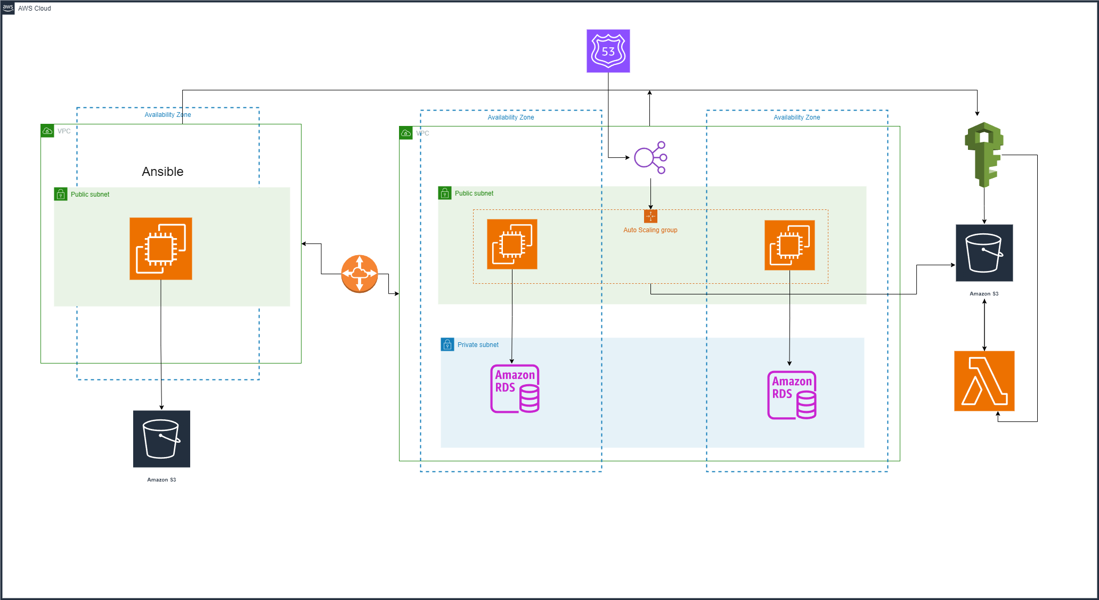
Infrastructure design

Slide 13
Thank You

Slide 14







Icons
Architecture
Commerce
Legal Studies
Arts & Humanities
Performing Arts
Management Studies
Science & Tech
Engineering

